Slide 1

Tıme scheduling asp
Elif Ecem Ümütlü
Arda Bakkal
Sabri Yiğit Arslan
Murat Bayraktar
Ozan Cinci

Slide 2
Representation of Input
Generated facts: time_slot(ValidHour), busy(Teacher, ValidHour), capacity(room, capacity), room(ValidRoom), teaches(Teacher, courseId)
Generating Baseline
Each element in the set is represented as below:
occupies(Course, Section, Room, Teacher, Start, End, OccupiedHours)
If a (Course, Section) pair is conducted 3 hours, it is either split as 2 and 1 hour instances or 3 hour instance.
If a (Course, Section) pair is conducted 2 hours in total, it is remained as 2 hour instance.
{occupies(Course1, Section1, BMB1, Teacher1, 1010, 1012, 2),
occupies(Course1, Section1, BMB3, Teacher1, 1028, 1029, 1),
occupies(Course2, Section1, BMB1, Teacher2, 1056, 1059, 3),
…}
Changes on the Default Constraints
CORG capacity is decreased to 180 from 200
499 lecture hour increased to 3 from 1

Slide 3
Hard Constraints
Constraints on places:
Non-service undergraduate level courses cannot occupy a classroom longer than 2 hours consecutively. (while generating baseline)
One classroom cannot be occupied by more than one course at a time.
A course cannot be given in a room that is too small.
If a non-service undergraduate level course has split into three sections, one hour of lecture must be conducted at BMB1 at least.
If a non-service undergraduate level course has split into two sections, all hours must be conducted at BMB1 at least
Constraints on instructors:
An instructor can give at most one course at a time.
An instructor don’t give a course in their busy hour.

Slide 4
Soft Constraints
For a course, if there are 2 sections:
In courses with multiple instructors, each section must be taught by only one of them.
If sections are the same, teachers can't be different, this is grounded.
If sections are different, teachers must be different
For a course, if there are 3 sections:
If sections are the same, teachers can't be different, this is grounded. (INTRA-SECTION CONSISTENCY)
If sections are different, teachers must be different (INTER-SECTION CONSISTENCY)
Courses in the same cohort cannot be given at the same time (~).
Same course, same section different hour time difference should be greater than 38
Gaps between same cohorts should be minimized (~). The penalty applied is 5 points for each hour of gap. The below code is used for defining a penalty:
:~ gap_count(Course1, Section1, OccHour1, Course2, Section2, OccHour2, GapCount). [GapCount*5]

Slide 5
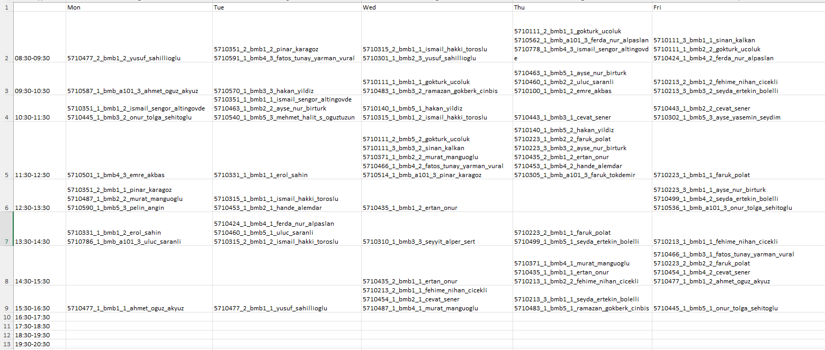
An Example Table Instance
courseId_section_room_consecutiveHours_teacherName

